Slide 1
Computer Networks and Network Security
Qiao Xiang
https://qiaoxiang.me/courses/cnns-xmuf21/index.shtml
9/14/2021
This deck of slides are heavily based on CPSC 433/533 at Yale University, by courtesy of Dr. Y. Richard Yang.

Slide 2
Outline
Administrative trivia’s
What is a network protocol?
A brief introduction to the Internet: past and present
Summary

Slide 3
Personnel
Instructor
Qiao Xiang, qiaoxiang@xmu.edu.cn
office hours： by appointment
Teaching assistant
Zhihao Zhang, zhihao@stu.xmu.edu.cn

Slide 4

Self-Introduction
Joined XMU as a professor this January
Research: Computer Networks, Computer Systems
Previously,
Research assistant professor, Yale University, US., 2019-2020
Postdoctoral fellow, Yale University, US. 2016-2018
Postdoctoral fellow, McGill University, Canada, 2014-2015
Ph.D. in Computer Science, Wayne State University, US, 2014
B.E. in Information Security and B.Econ., NKU, 2007

Slide 5
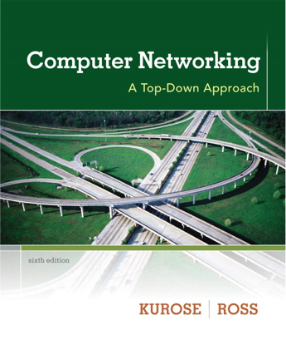
Textbook
Textbook
Computer Networking: A Top-Down Approach, 7/e by Jim Kurose and Keith Ross
Reference books
Computer Networks by Tanenbaum and Wetherall
Computer Networks, A Systems Approach by Larry Peterson and Bruce Davie
TCP/IP Illustrated, Volume 1: The Protocols by W. Richard Stevens
Java Network Programming, by Elliotte Harold
Resources
https://qiaoxiang.me/courses/cnns-xmuf21/index.shtml
on

Slide 6
What are the Goals of this Course?
Learn design principles and techniques of:
the Internet infrastructure (Internet service provider, data center, cloud)
large-scale Internet applications
Focus on how the principles and techniques apply and adapt in real world:
real examples from the Internet

Slide 7
Computer Networks and Network Security vs. Computer Networks and Communication
CNNS:
Bilingual:
English in slides / homework / exams
Chinese in lecture / lab classes / discussions
More emphasis on design principles, theories and programming
More emphasis on security issues
Less emphasis on communication (e.g., physical layer and wireless networks)
A top-down roadmap

Slide 8
Why Study Computer Networks?
Looking for a job
Domestic | International
Huawei | Amazon
Alibaba | Google
Tencent | Microsoft
Xiaomi | Facebook
JD | Uber
… | …

Slide 9


Why Study Computer Networks?
Be an entrepreneur

Slide 10




Why Study Computer Networks?
Pursue graduate degrees overseas

Slide 11





Why Study Computer Networks?
Pursue graduate degrees domestically
Xin Jin
PKU
Tong Yang
PKU
Chenren Xu
PKU
Linghe Kong
SJTU
If you are interested in working with me on research projects, please send me an email at qiaoxiang@xmu.edu.cn
Chen Tian
NJU
Peng Zhang
XJTU
Qiao Xiang
XMU
Lu Tang
XMU

Slide 12
What Do You Need To Do?
Please go to the class website to fill out the class background survey
help us determine your background
help us determine the depth, topics, and the details of assignments
suggest topics that you want to be covered (if you think of a topic later, please send me email)

Slide 13
What Do You Need To Do?
Your workload
6 lab assignments
2 written assignments
4 programming assignments
one HTTP 1.0 server, one TCP, one routing protocol, one programmable network
1 class project （2-4 persons a team)
2 exams

Slide 14
How to Succeed in this Class?
Engage in lectures
Questions are highly encouraged
Read textbooks / references / online materials
Apply the principles / techniques you learned in lectures to assignments and the project
Do not procrastinate assignments and the project
For programming assignments and projects, follow the timeline of checkpoints to avoid the deadline panic

Slide 15
Class Project
Research or engineering project related to computer networks and network security
Grading criteria:
Innovation 25%, Practicality 25%, Completeness 25%, Presentation 25%
Suggestions
Identify teams and talk to the instructor to decide on the topic as early as possible
Read latest papers/technical documents to get inspiration
If possible, target research papers / patents

Slide 16
Grading
Class Participation | 10%
Lab Assignments | 40%
Class Project | 15%
Exams | 15%+20%
Grades are important, but you do not need worry too much about them
More important is what you realize/learn than the grades !!

Slide 17
Questions?

Slide 18
Outline
Administrative trivia’s
What is a network protocol?

Slide 19
What is a Network Protocol?
A network protocol defines the format and the order of messages exchanged between two or more communicating entities, as well as the actions taken on the transmission and/or receipt of a message or other events.

Slide 20
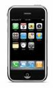
Example Protocol: Simple Mail Transfer Protocol (SMTP)
Messages from a client to a mail server
HELO
MAIL FROM: <address>
RCPT TO: <address>
DATA <This is the text end with a line with a single .>
QUIT
Messages from a mail server to a client
status code
The first digit of the response broadly indicates the success, failure, or progress of the previous command.
1xx - Informative message
2xx - Command ok
3xx - Command ok so far, send the rest of it.
4xx - Command was correct, but couldn't be performed for some reason.
5xx - Command unimplemented, or incorrect, or a serious program error occurred.
content
outgoing
message queue
user mailbox
user
agent
mail
server
user
agent
SMTP
mail
server
user
agent
SMTP
SMTP
mail
server
user
agent
POP3,
IMAP SMTP
user
agent
user
agent
Command: %telnet smtp.xmu.edu.cn 25
Notes:
RCPT TO: <> notify=success,failure

Slide 21
Example Protocol: TCP Connection Close Protocol
Why connection close?
so that each side can release resource and remove state about the communication
client
server
init. close
release
resource?
I am done. Are you done too?
close
I am done too. Goodbye!
release
resource?
close
release
resource?

Slide 22
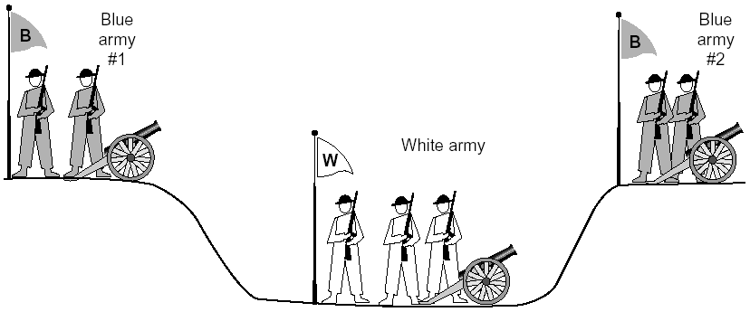
General Case: The Two-Army Problem
The gray (blue) armies need to agree on whether or not they will attack the white army. They achieve agreement by sending messengers to the other side. If they both agree, attack; otherwise, no. Note that a messenger can be captured!

Slide 23
Example: TCP Protocol Handshakes
Host A
SYN(seq=x)
Host B
ACK(seq=x), SYN(seq=y)
ACK(seq=y)
DATA(seq=x+1)
ACK
FIN
ACK
FIN
ACK

Slide 24
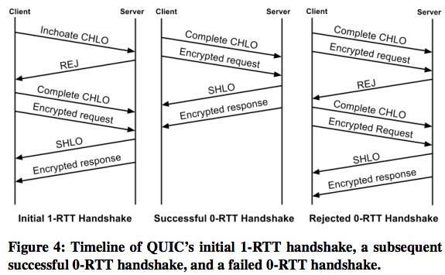
Example: Google’ new QUIC
http://conferences.sigcomm.org/sigcomm/2017/files/program/ts-5-1-QUIC.pdf

Slide 25
Protocol Standardization
Most widely used protocols are defined in standards
Why standard?

Slide 26
Internet Standardization Process
All standards of the Internet are published as RFC (Request for Comments)
e.g., the SMTP protocol is specified in RFC821
but not all RFCs are Internet Standards: http://qiaoxiang.me/courses/cnns-xmuf21/readings/interestingrfcs.html

Slide 27
Internet Standardization Process
All standards of the Internet are published as RFC (Request for Comments)
e.g., the SMTP protocol is specified in RFC821
but not all RFCs are Internet Standards: http://qiaoxiang.me/courses/cnns-xmuf21/readings/interestingrfcs.html
A typical (but not the only) way of standardization:
Internet draft
RFC
proposed standard
draft standard (requires 2 working implementations)
Internet standard (declared by Internet Architecture Board)
David Clark, 1992:
We reject: kings, presidents, and voting. We believe in: rough consensus and running code.

Slide 28

Outline
Administrative trivia’s
What is a network protocol?
A brief introduction to the Internet
past (a brief history)
present

Slide 29
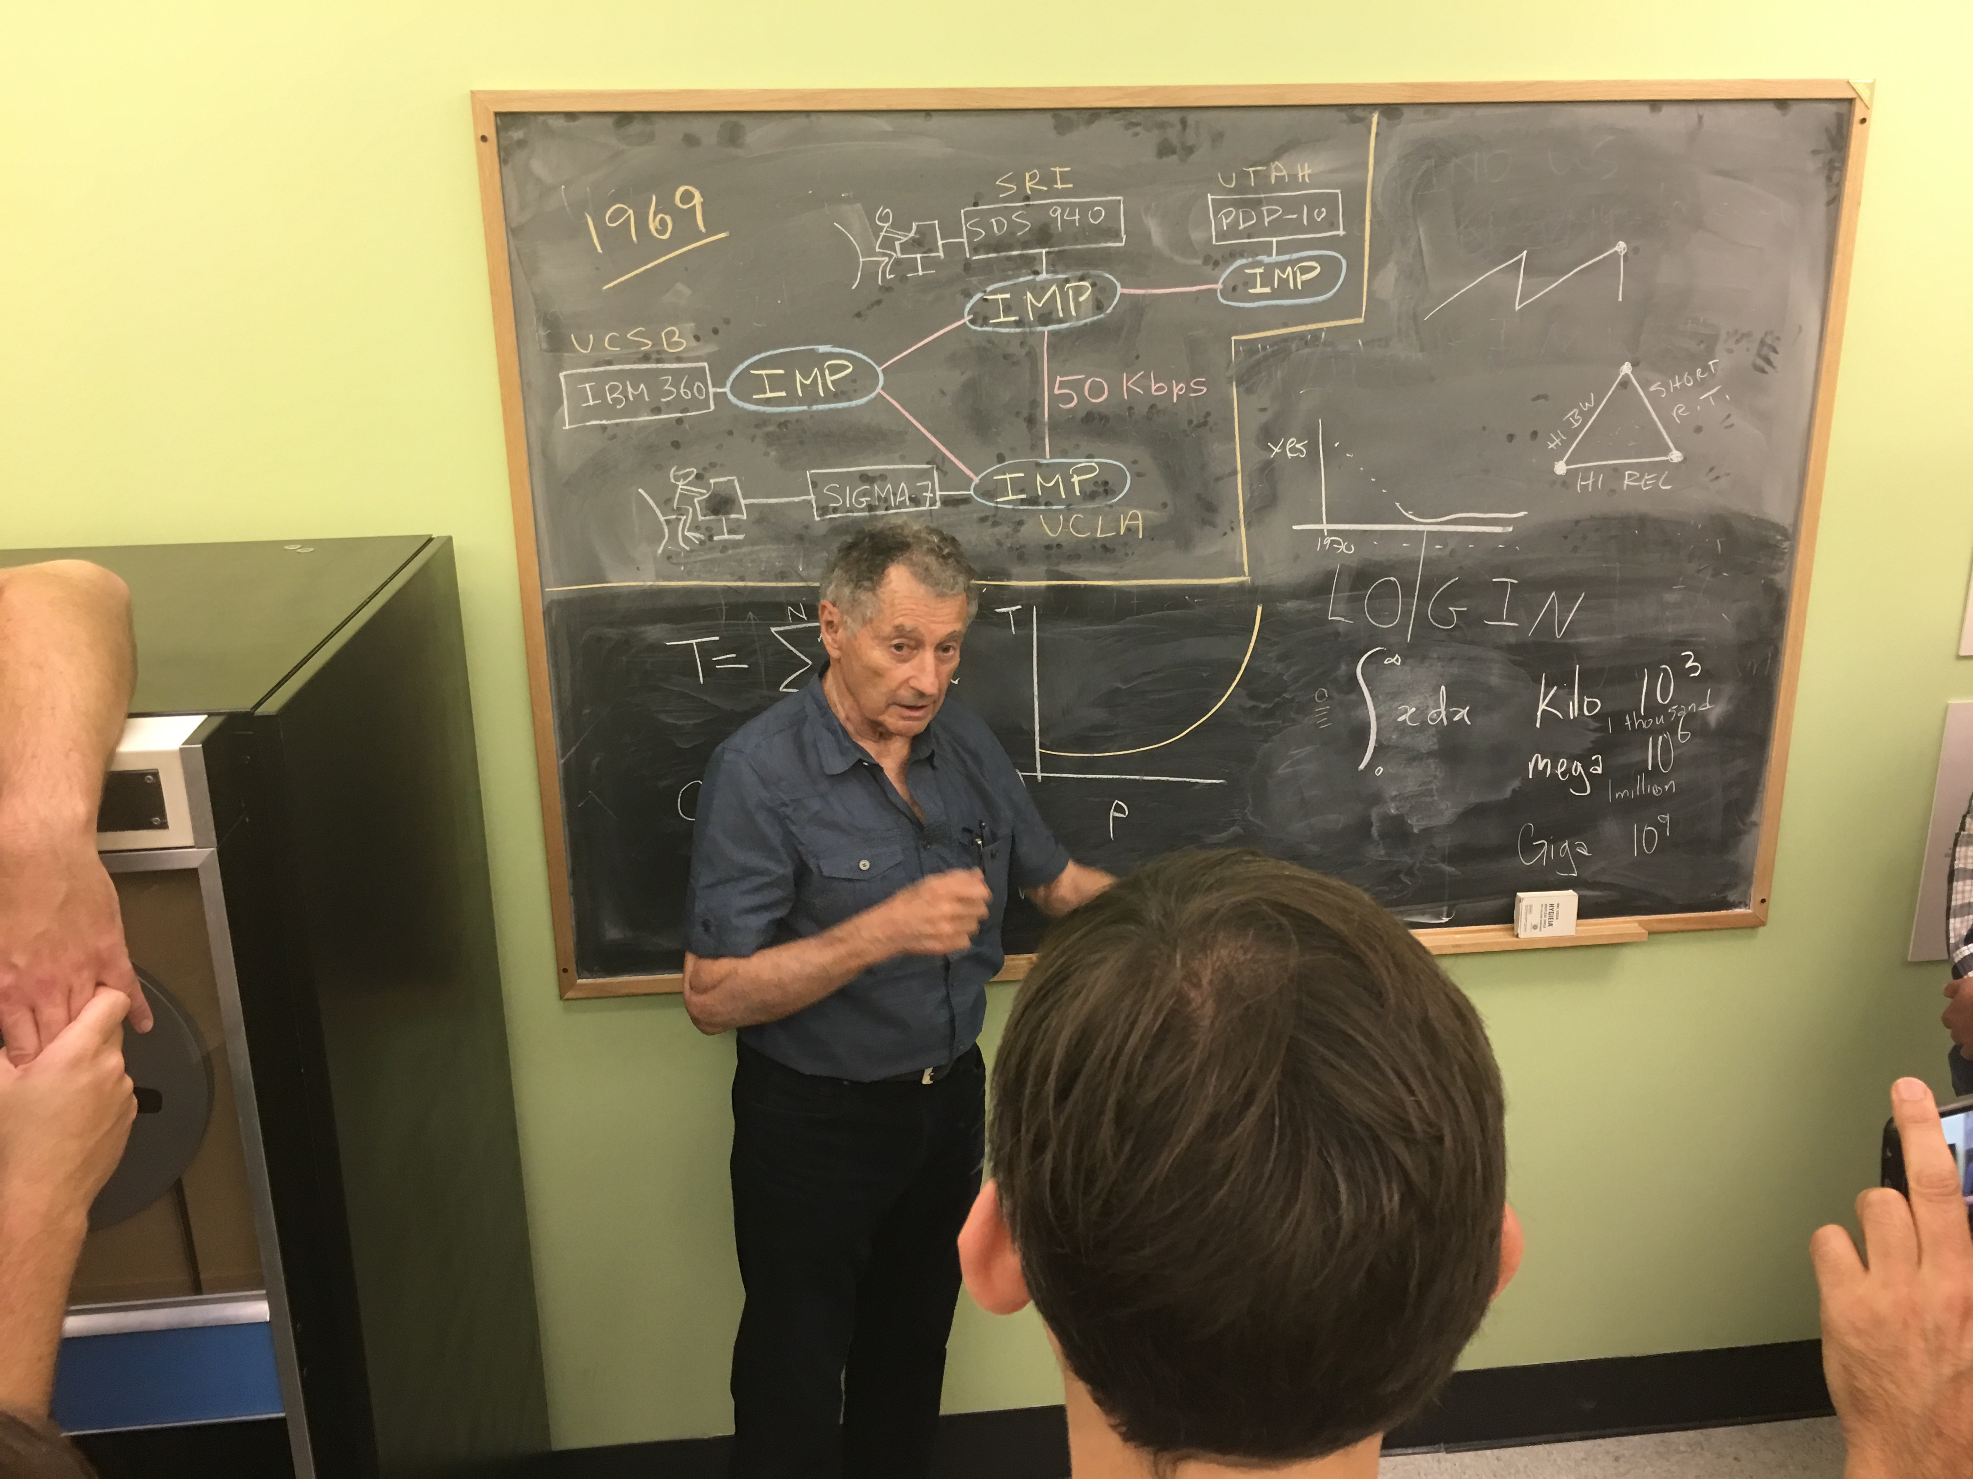
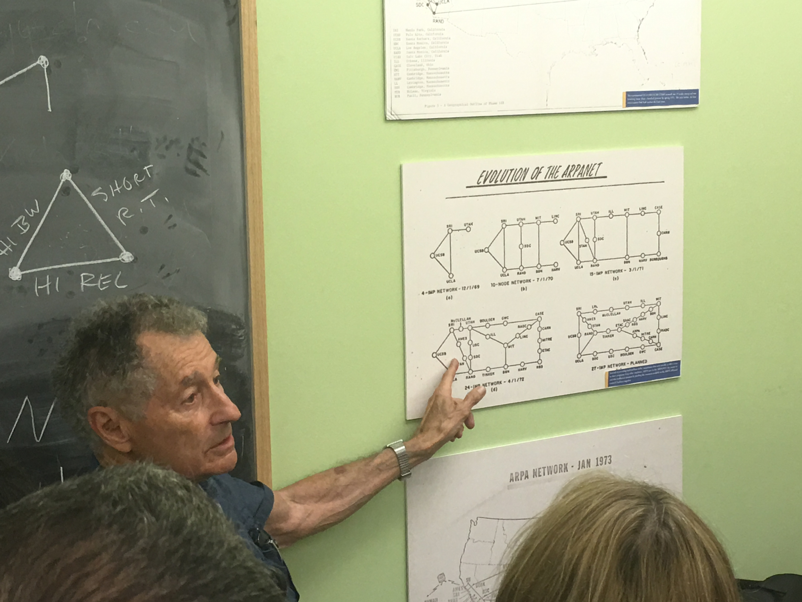
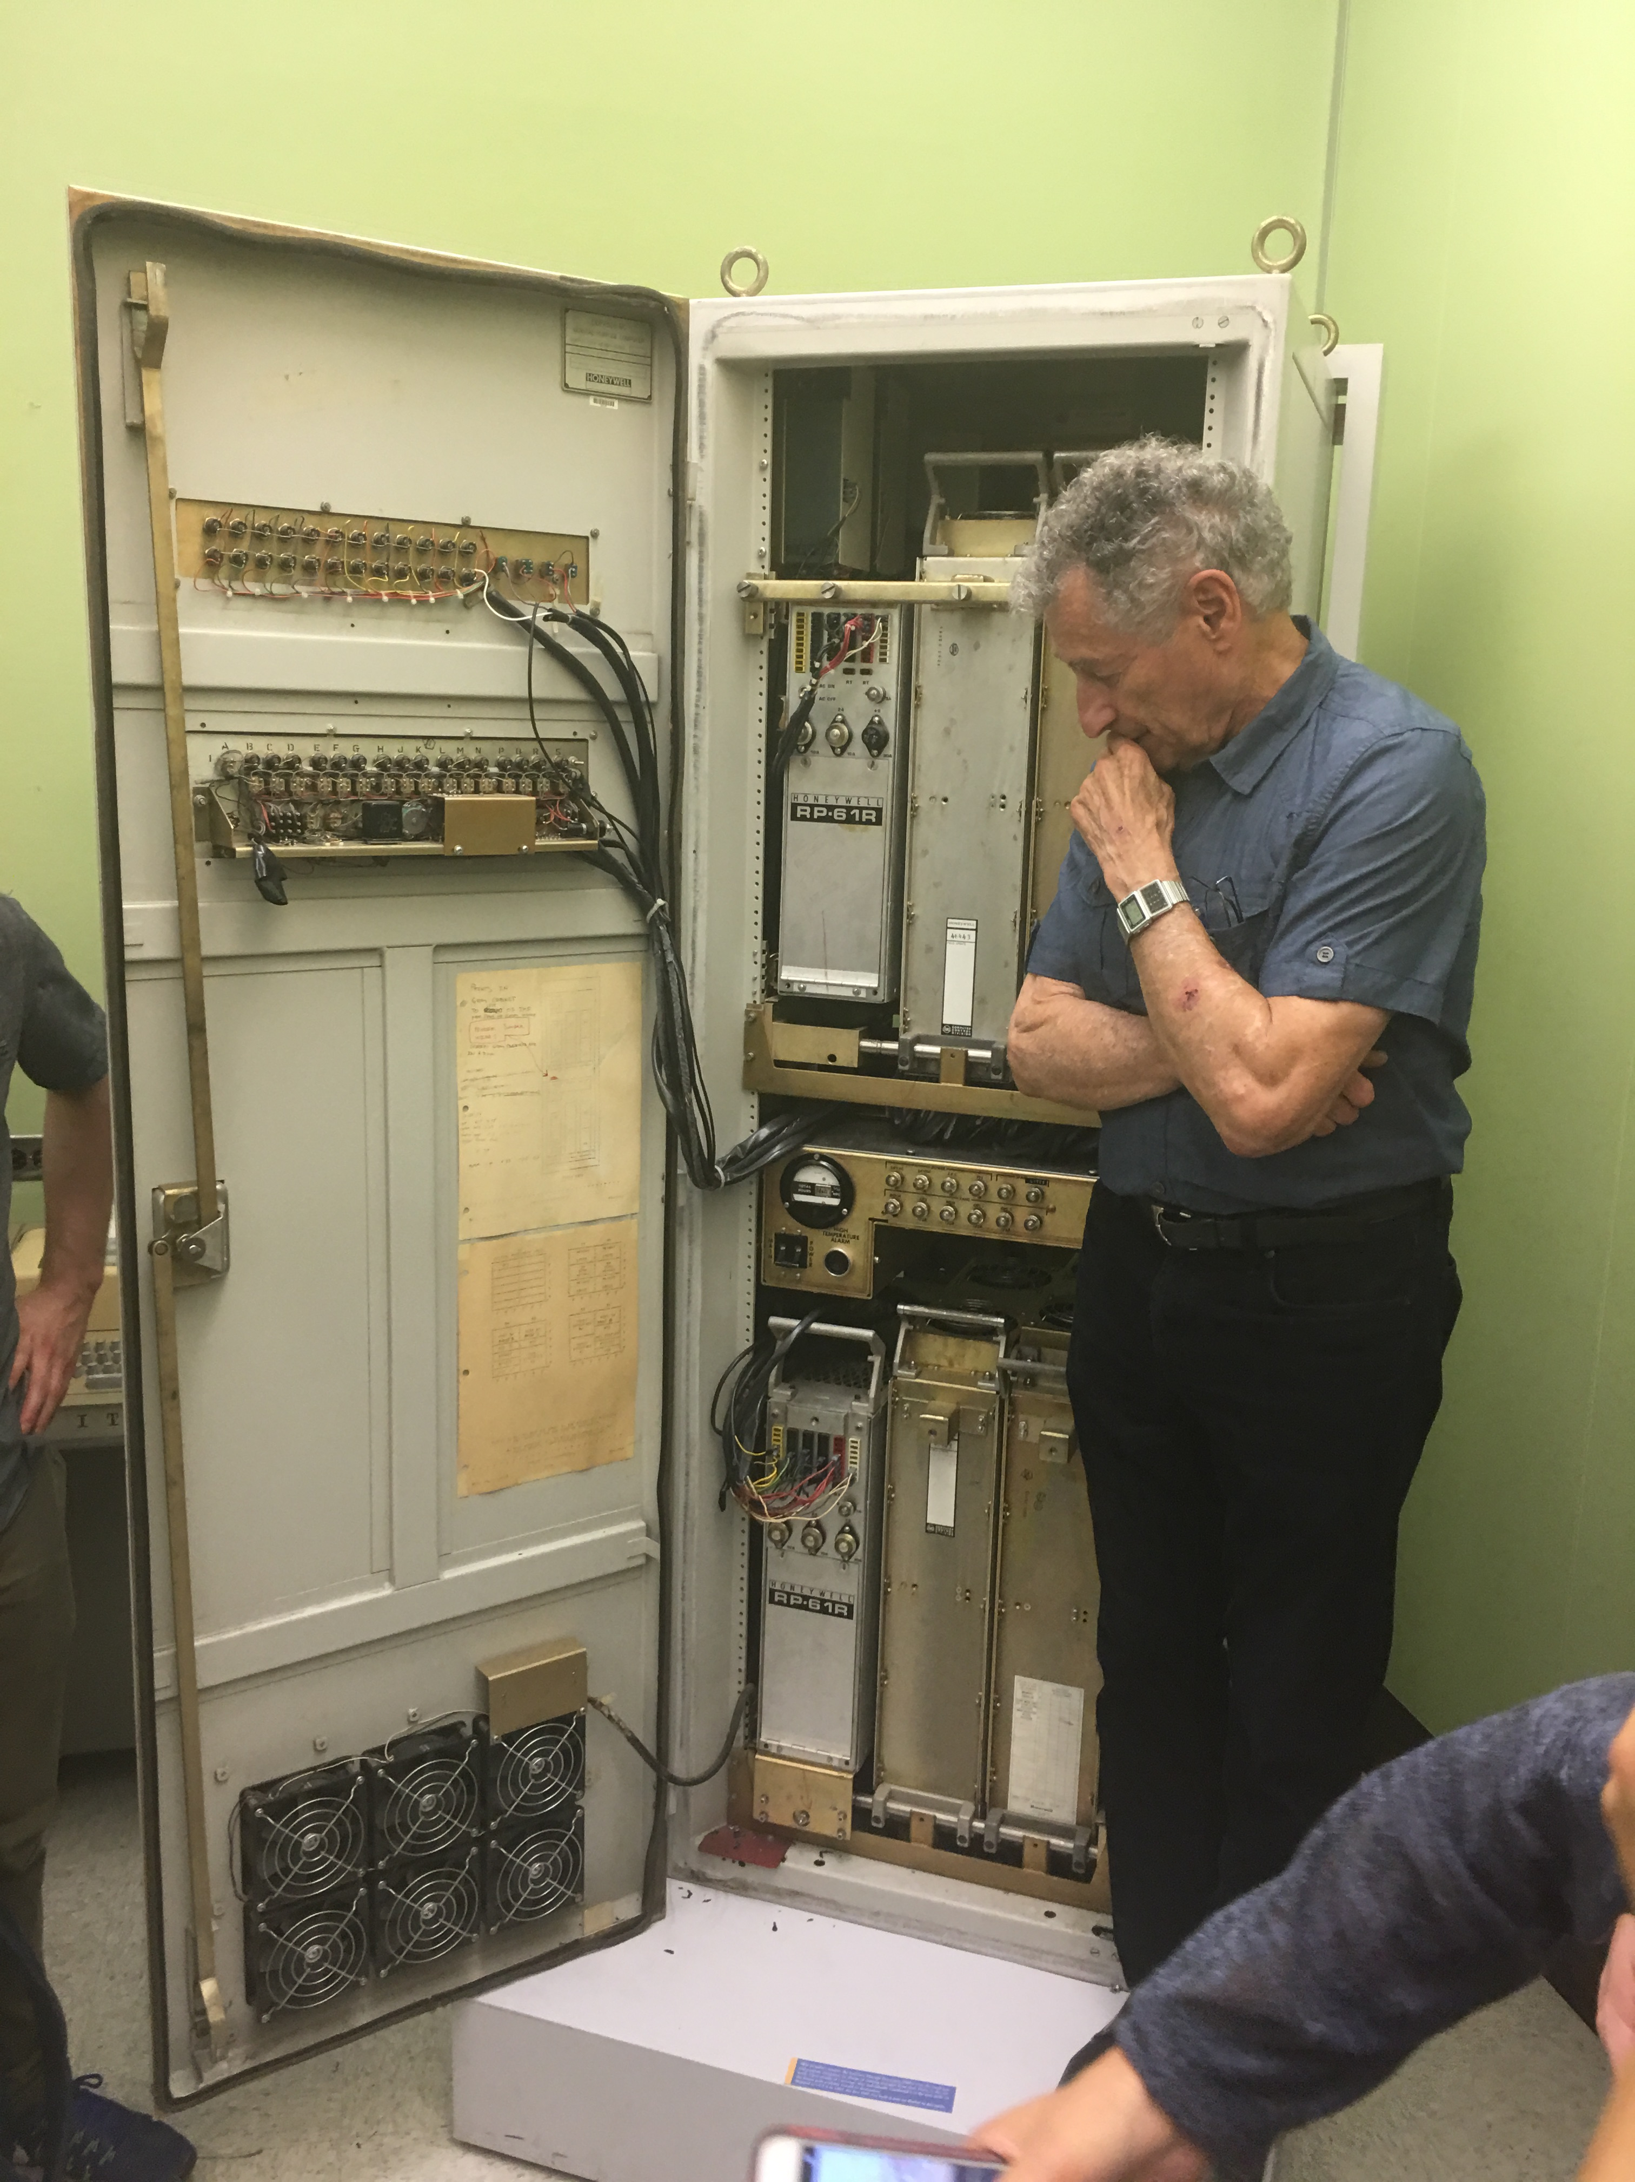
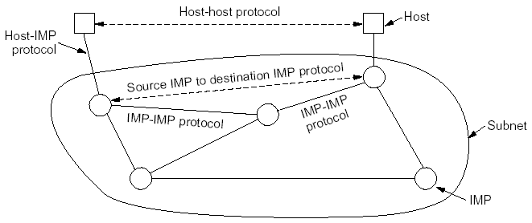
Prelude: Packet Switching and ARPANET
1957
USSR launched Sputnik; US DoD formed Advanced Research Projects Agency (ARPA)
1961
First paper by Len Kleinrock on packet switching theory
1964
Paul Baran from RAND on design of packet switching networks
1965-1968
ARPANET plan
Bolt Beranek and Newman, Inc. (BBN), a small company, was awarded Packet Switch contract to build Interface Message Processors (IMPs)

Slide 30
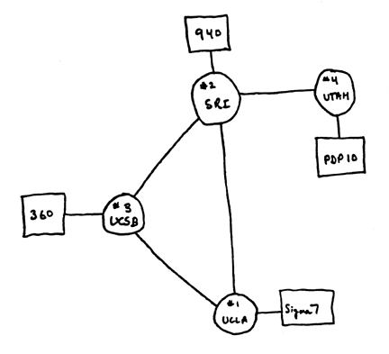
Internet 1.0: Initial ARPANET
1969
ARPANET commissioned: 4 nodes, 50kbps

Slide 31
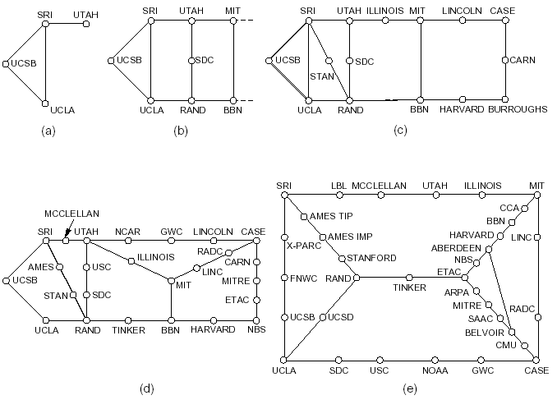
Initial Expansion of the ARPANET
Dec. 1969
July 1970
Mar. 1971
Apr. 1972
Sept. 1972
RFC 527: ARPAWOCKY; RFC 602: The Stockings Were Hung by the Chimney with Care

Slide 32
The Internet Becomes a Network of Networks
1970: ALOHAnet, the first packet radio network, developed by Norman Abramson, Univ of Hawaii, becomed operational
1973: Bob Kahn posed the Internet problem---how to connect ARPANET, packet radio network, and satellite network
1974: Vint Cerf, Bob Kahn published initial design of TCP (NCP) to connect multiple networks
- 1978: TCP (NCP) split to TCP/IP
- 1983: TCP (NCP) converted to TCP/IP (Jan. 1)

Slide 33
Growth of the Internet
1981: BITNET (Because It’s Time NETwork) between CUNY and Yale
1986: NSF builds NSFNET as backbone, links 6 supercomputer centers, 56 kbps; this allows an explosion of connections, especially from universities
1987: 10,000 hosts
1987： China's first email "Across the Great Wall we can reach every corner in the world" sent to Germany
1988: Internet congestion collapse; TCP congestion control
1989: 100,000 hosts RFC 1121: Act One – The Poem WELCOME by Leonard Kleinrock We've gathered here for two days to examine and debate And reflect on data networks and as well to celebrate. To recognize the leaders and recount the path we took. We'll begin with how it happened; for it's time to take a look. Yes, the history is legend and the pioneers are here. Listen to the story - it's our job to make it clear. We'll tell you where we are now and where we'll likely go. So welcome to ACT ONE, folks.
Sit back - enjoy the show!!

Slide 34
Internet 2.0: Web, Commercialization, Social Networking of the Internet
1990: ARPANET ceases to exist
1991: NSF lifts restrictions on the commercial use of the Net; Berners-Lee of European Organization for Nuclear Research (CERN) released World Wide Web
1992: 1 million hosts (RFC 1300: Remembrances of Things Past)
1994: China's first 64K dedicated circuit to the Internet
1998: Google was founded
2004: Facebook was founded
2006: Amazon AWS cloud computing
For a link of interesting RFCs, please see http://qiaoxiang.me/courses/cnns-xmuf21/readings/interestingrfcs.html
For more on Internet history, please see http://www.zakon.org/robert/internet/timeline/

Slide 35
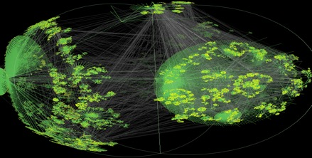
Growth of the Internet in Terms of Number of Hosts
Number of Hosts on the Internet:
Aug. 1981 213
Oct. 1984 1,024
Dec. 1987 28,174
Oct. 1990 313,000
Jan. 1993 1,313,000
Jan. 1996 9,472,000
Jan. 1999 43,218,000
Jan. 2002 147,344,723
Jan. 2005 317,646,084
Jan. 2007 433,193,199
Jan. 2010 732,740,444
Jan. 2013 963,518,598
Jan. 2016 1,048,766,623
Jan. 2017 1,062,660,523
CAIDA router
level view
http://ftp.isc.org/www/survey/reports/current/

Slide 36


Internet 3.0: Always-Connected, Virtualized Life
Office
Shopping
Education
Entertainment
Environment
=> Virtual workspace
=> Online shopping
=> Remote education
Online media/games
Internet of things

Slide 37
Internet in China
5 major networks: CHINANET, UNINET, CMNET, CERNET, CSTNET
International exit bandwidth: 8.8Tbps, 2019
4G base stations: >5.5 million (<9 million globally)
5G base stations: ~0.7 million (~70% of the world), 2020

Slide 38
What Will We Cover?
Network architecture and design principles
Layered network arch; e2e principle
Application architecture and design principles
application paradigms; high performance network app.
HTTP/Web, Email, DNS, P2P, Blockchain, Content distribution
Transport
transport services
reliability; distributed resource allocation; primal-dual
transport protocols: TCP/UDP

Slide 39
What Will We Cover?
Network and link layers
distributed, asynchronous, autonomous routing algorithms; scalable router design; IP/IPv6; mobile IP; cellular networks
multiple access; queueing analysis; capacity analysis
Next-generation network:
Cloud and data center design, programmable networks, RDMA
Physical layer
Wireless Networks
Network security
security primitives; BAN logic, SSL

Slide 40
Summary
Course administration
A protocol defines the format and the order of messages exchanged between two or more communicating entities, as well as the actions taken on the transmission and/or receipt of a message or other events.
The past:
facts:
The Internet started as ARPANET in late 1960s
The initial link bandwidth was 50 kbps
The number of hosts at the end of 1969 was 4
some implications of the past:
ARPANET is sponsored by ARPA →
The initial IMPs were very simple →
Many networks →
Current:
The number of hosts connected to the Internet is around 1 billions
The backbone speed of the current Internet is about 40/100 Gbps
The Internet is roughly hierarchical where ISPs interconnect at PoP and IXP
Needs to handle scale, complexity, decentralization, security
design should survive failures
keep the network simple
need a network to connect networks

Slide 41
Preview
We have only looked at the topology/connectivity of the Internet
a communication network is a mesh of interconnected devices
A fundamental question: how is data transferred through a network?

